Slide 1
Stepping Forward …
Hyung-Sin Kim
Computing Foundations for Data Science
Graduate School of Data Science, Seoul National University

Slide 2
Final
6/14(Mon) 7~9PM, 942동 3층 (연구공원)
응시인원: 수강생 57명 + 청강생 19명
준비물: 신분증
10문제, 100점 만점
Still making problems… ☺

Slide 3
Practice – Delete a node from SLList
For simplicity, we assume that every node has a unique integer
Step 1) Make SLList work first
It can take some time because you are unfamiliar yet! Discuss with your peers!
Step 2) Make a search function
LinkedNode *searchNode(SLList *LL, int x) { /* Your code */ }
Step 3) Make a delete function that is a bit more complex than SearchNode since you need to reorganize next pointers and decrease list size
void deleteNode(SLList *LL, int x) { /* Your code */ }

Slide 4
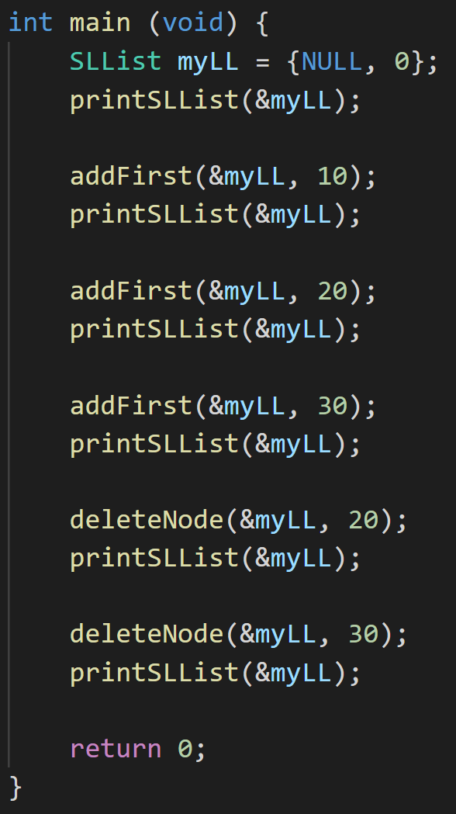
Practice – Delete a node from SLList
What do you see on your screen when you write the main function as that on the right side?
I mean… if your code ever works… ☺

Slide 5
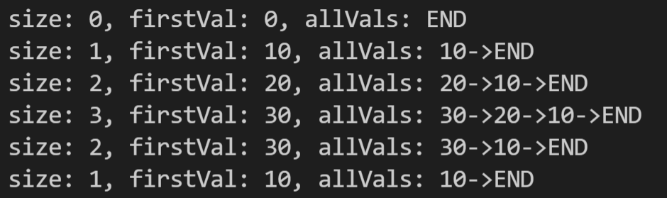
Practice – Delete a node from SLList
What do you see on your screen when you write the main function as that on the right side?
I mean… if your code ever works… ☺

Slide 6
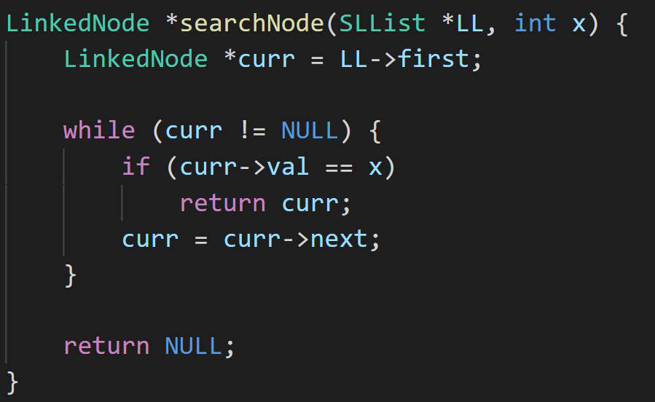
Practice – Delete a node from SLList
searchNode implementation

Slide 7
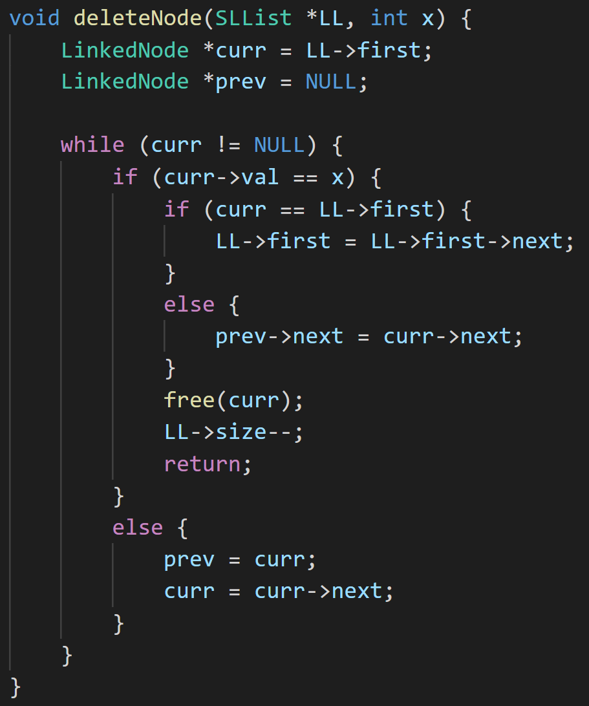
Practice – Delete a node from SLList
deleteNode implementation

Slide 8



Slide 9

This Course was Designed for…
Students who do not have much computing/programming background
To make them learn a lot in a condensed way: Python, Data Structures and Algorithms, System basics, and C ☺
To have basic skills and knowledge to keep up with the GSDS curriculum

Slide 10
Methodology – Learn by Doing
To make that really happen, our methodology was as follows:
24 lectures, 19 in-class practices, 14 assignments, 7 projects, and 2 exams
Study group organization, in-class group discussion, in-class coding and analysis, animation on slides, after-class Q&A, ETL discussion
Mindset of a helper, not a judge

Slide 11
Do You Remember What I Said in the First Class?
This course is not easy! It will require devotion
You will learn a lot (three in one) and there will be a lot of assignments
If you don’t have that much time, I recommend another class with the same title (Prof. Choi)
Do you agree? ☺☺

Slide 12

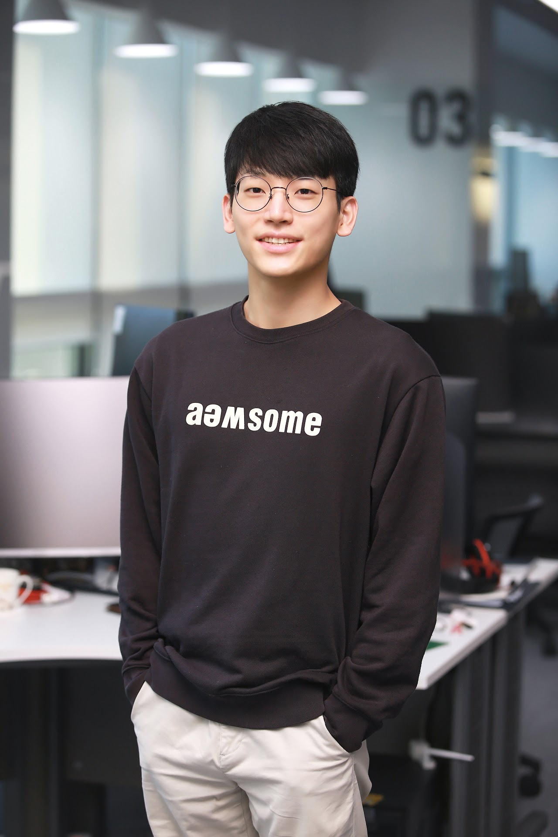
Special Thanks to…
박건도
김우중

Slide 13
What We have Covered So Far …
Python programming
Interpreter
Data types, variables, and operators
Memory model
Functions
Control Structures and loops
File I/O
Modules
Classes
Object-oriented programming
C programming
Compiler
Data types, variables, and operators
Memory model
Functions
Control Structures and loops
I/O and File I/O
Pointers
Structures
Dynamic memory allocation

Slide 14
What We have Covered So Far …
Data structures
Linked lists (both in Python and C)
Array lists (Python lists, C arrays)
Hash tables (Python sets) and Hash maps (Python dictionaries)
Binary search trees
Trees and traversals
Graphs and traversals
Algorithms
Performance evaluation (Big O and actual measurement)
Linear search and binary search
Selection sort, insertion sort, and merge sort
Recursion

Slide 15
What We have Covered So Far …
System basics
Bits, data types, and operations
Semi-conductor and logic gates
Von Neumann model and machine codes
Great ideas in computer architecture
Technical interview practice
Guest lecture

Slide 17
Please Participate!
https://docs.google.com/forms/d/e/1FAIpQLSclXqeMyOimOfHkV4s783gW3w0aJoZJrx01Lf1IFnCpC1eHSg/viewform?usp=sf_link

Slide 18

Computing Foundations for Data Science:
A Pathway toward…

Slide 19
To Step Forward …

Slide 20
To Step Forward …
Data structures and Algorithms
GSDS: 데이터사이언스를 위한 소프트웨어 플랫폼 (1학기)
ECE: 자료구조의 기초 (2학년), 알고리즘의 기초 (3학년)
CSE: 자료구조 (2학년), 알고리즘 (3학년)
Object-oriented programming (and c++)
ECE: 프로그래밍 방법론 (2학년)
CSE: 컴퓨터프로그래밍 (2학년)
Deep neural network programming
GSDS: 데이터사이언스를 위한 소프트웨어 플랫폼 (1학기), 데이터사이언스를 위한 머신러닝 및 딥러닝 (1학기), 앰비언트 인공지능 플랫폼 및 실습 (2학기)

Slide 21
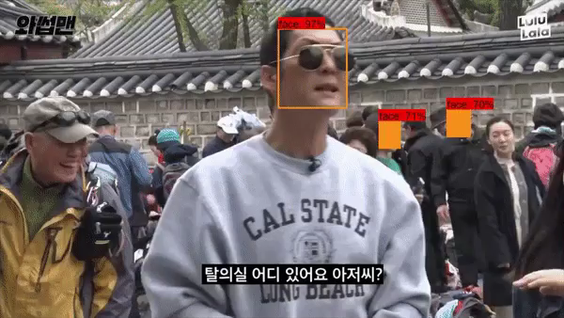
A2I Projects – Face Filtering

Slide 22

A2I Projects – Safety

Slide 23
To Step Forward …
Computer systems
GSDS: 확장형 고성능 컴퓨팅 (2학기)
ECE: 운영체제의 기초 (4학년)
CSE: 시스템프로그래밍 (2학년), 운영체제 (3학년), 멀티코어 컴퓨팅 (4학년)
Database
GSDS: 빅데이터와 지식관리 시스템 (1학기)
CSE: 데이터베이스 (3학년)
Computer architecture
ECE: 컴퓨터조직론 (3학년)
CSE: 컴퓨터구조 (2학년)

Slide 24
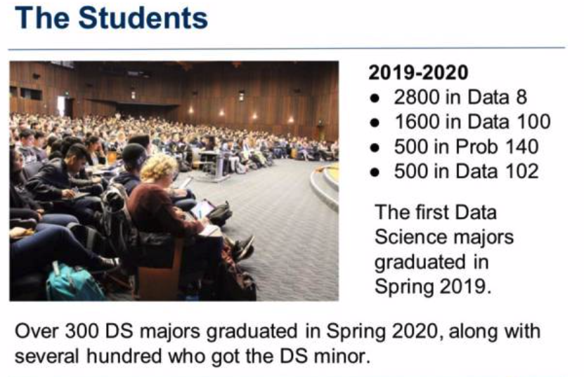
Data Science as Liberal Arts in the 21-th Century

Slide 25
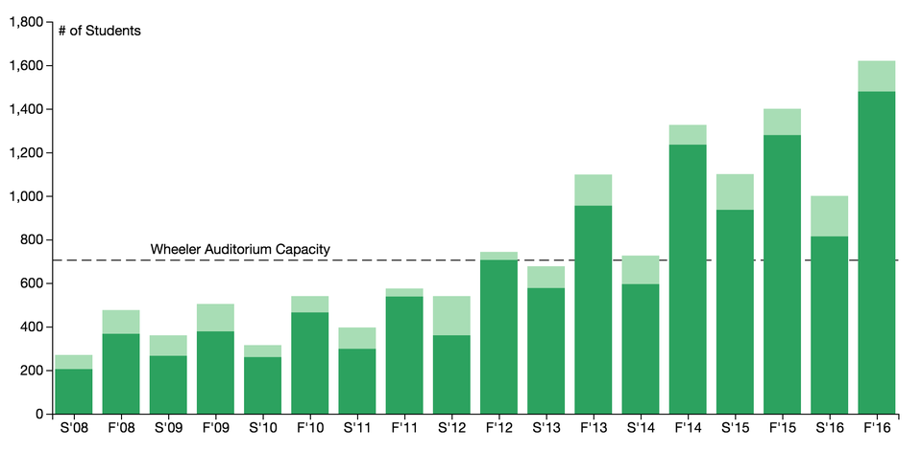
Data Science as Liberal Arts in the 21-th Century

Slide 26
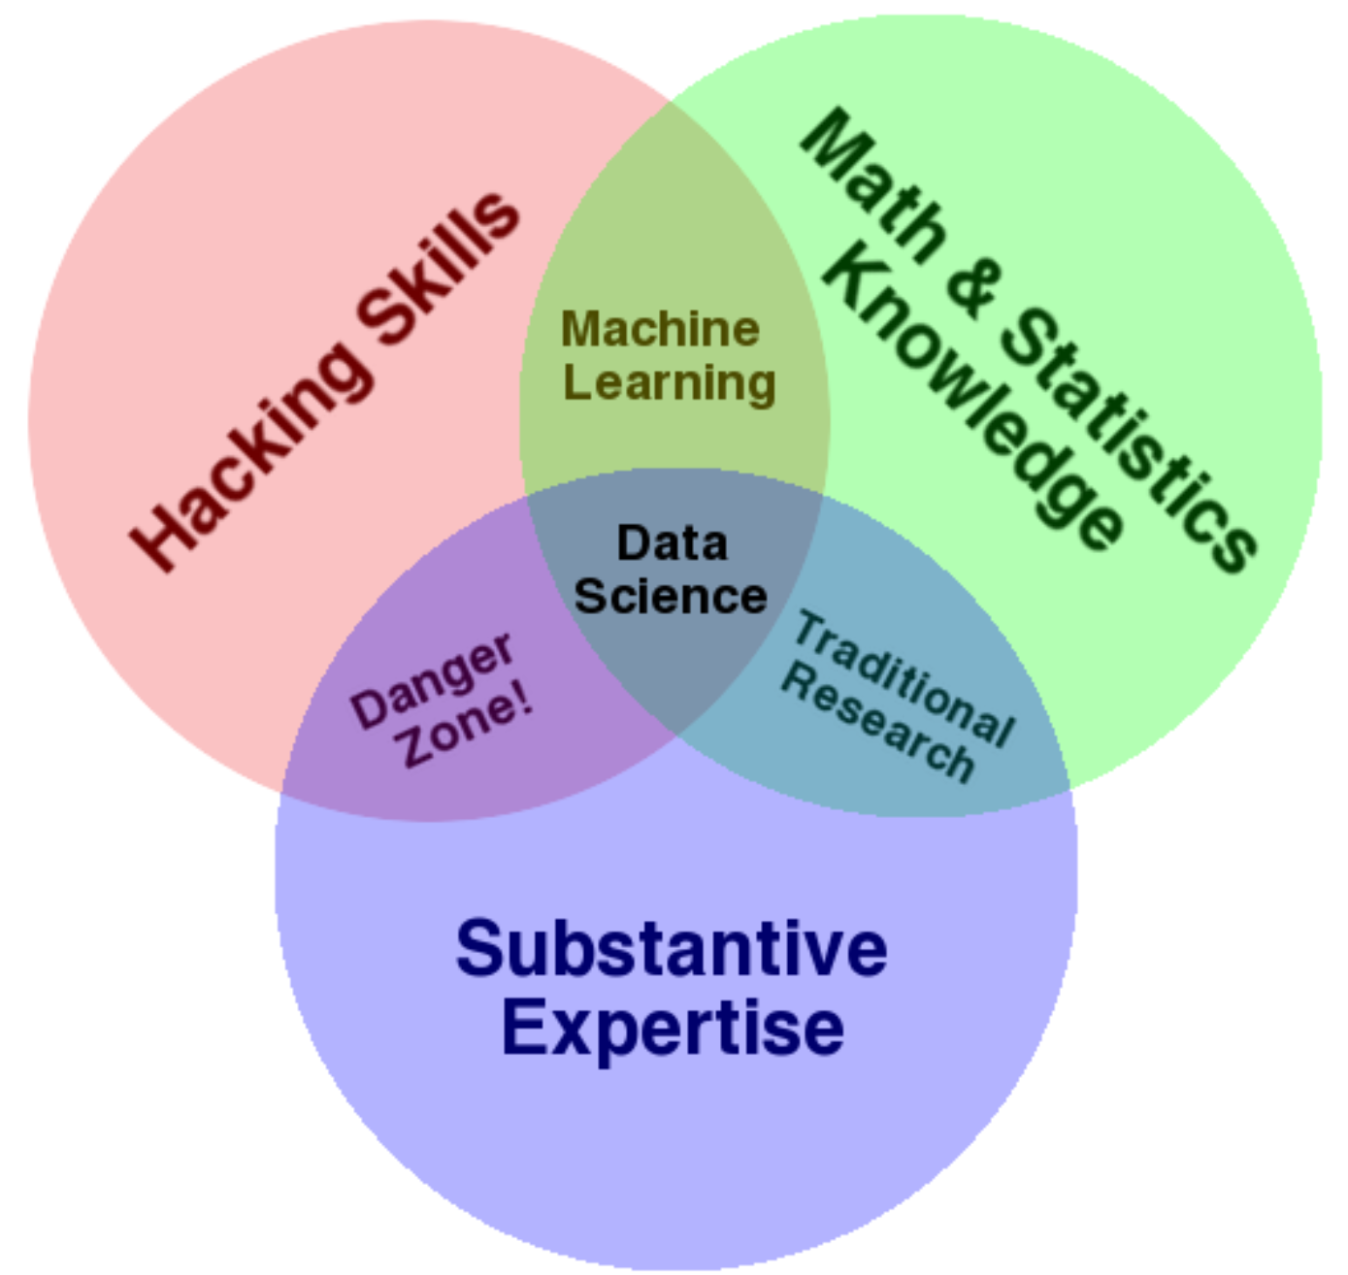
Drew Conway’s Venn Diagram (2010)

Slide 27

Again, Psychological Barrier is the Main Hurdle

Slide 28
Thanks!
[The image is from sleepcycle.com]

